Slide 1




STUDY OF COOPERATION IN MICROBIAL COMMUNITIES BY DIVISION OF LABOUR
Luis Chaves - MEng final year project presentation
Supervision: Dr. Ledesma-Amaro
The artisan against the assembly line.

Slide 2
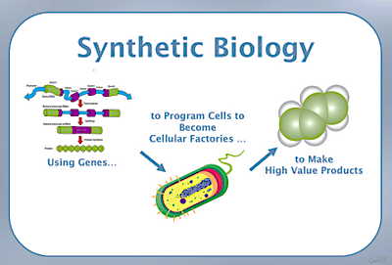
Synthetic biology & metabolic engineering
Chemistry
Control Engineering
Metabolic engineering
Synthetic biology
Mathematical modelling
Biology
Aims at the design and construction of new biological parts, devices and systems (The Synthetic Biology project)
By Andreas Christodoulou, in the officinal AndreasCY blog
High-value products can be human insulin, immunosuppresants, vitamin precursors, biodiesel…
Notes:
Synbio is the combination of these disciplines and it’s a growing field with no fixed definition as of today. Aims + define parts (modular components/molecules with particular function that can be assembled together and not lose function). Synbio is believed to revolutionise the way we will live in the future.
MetEng is in general terms using cell as protein factories to make high value products at low cost, really fast turnover, cheap, low resource, low space and easy to manipulate, easier than plants for example. Novel metabolic pathways requires optimization and several pre-requirements such as cell host choice, computational modelling…

Slide 3
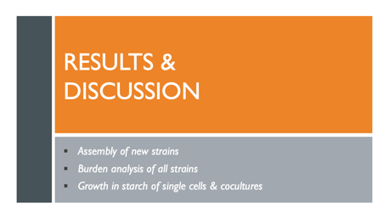
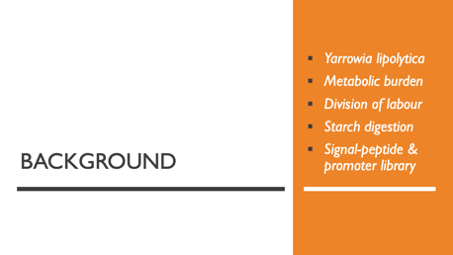
Presentation overview

Slide 4
background
Yarrowia lipolytica
Metabolic burden
Division of labour
Starch digestion
Signal-peptide & promoter library

Slide 5
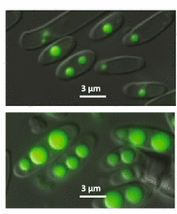

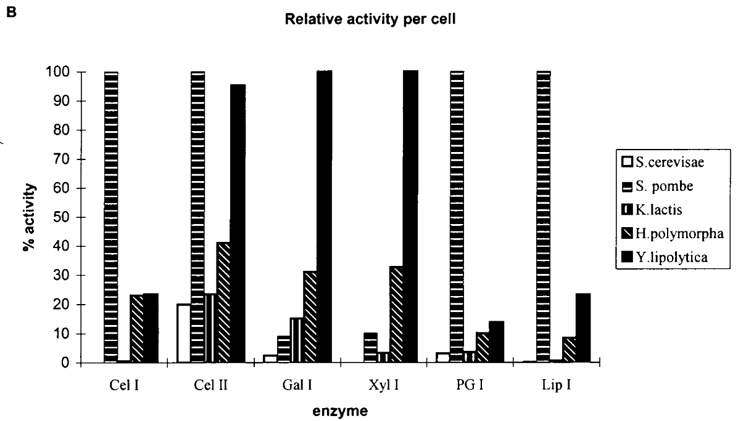
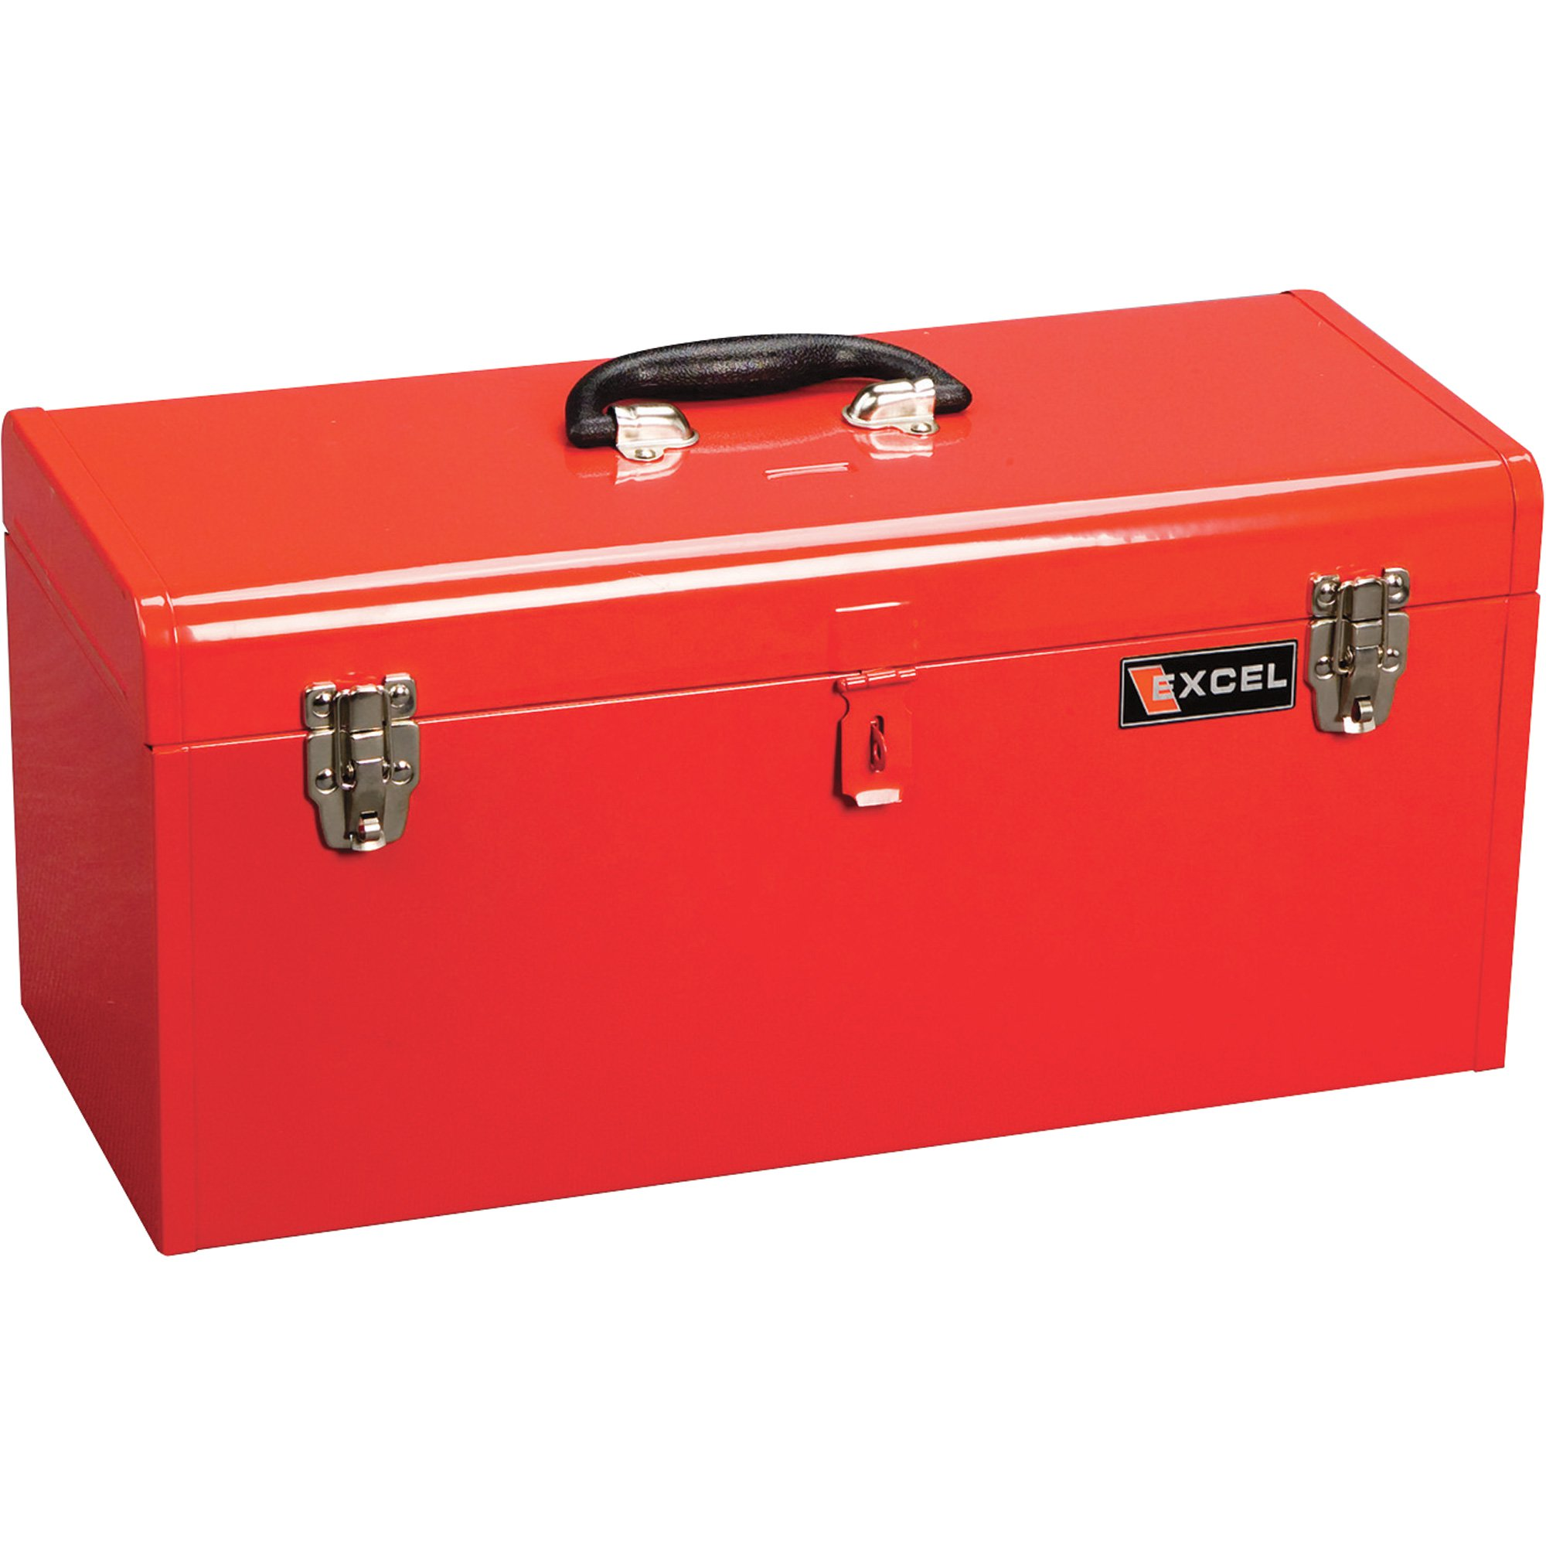
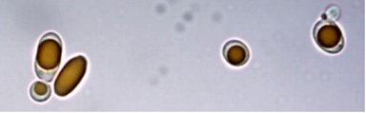
Yarrowia lipolytica, an excellent protein factory
Right: Y. lipolytica strain engineered to accumulate lipids to be used biodiesel. (Ledesma et. al 2015)
Bottom: Y. lipolytica engineered to produce beta-carotene (Larroude et.al 2018)
Constitutive
and
inducible
Constitutive
and
inducible
Hi-troughput
transformation
protocols
Hi-troughput
transformation
protocols
Golden gate
assembly method
Golden gate
assembly method
Sequenced
genome
Sequenced
genome
Main interesting features, excellent at:
Secreting protein
Hydrolysing lipids
Degrading extracellular proteins
Extensive toolbox
Extensive toolbox
Observed secretory potential up to two orders of magnitude higher than S.cerevisiae.
S.Cerevisiae
Y. lipolytica
Sven Müller et al., Yeast 1998
Notes:
Much better at secreting proteins which facilitates task as purification or extraction by cell lysis not necessary. Also S. pombe and H polymorpha showed poor transformation efficiency and protein glycosylation problems rendering Y. lipolytica the best non-conventional candidate to dethrone S. cerevisiae. Additionally, large toolbox, with sequenced genome, well characterized constitutive and inducible promoters, terminators, high throughput– high efficiency transformation protocols, golden gate assembly method for YL, selection markers, codon optimization tools… with such tools Y.L strains have been engineered to thing such as accumulate lipids to be used as bioguel from raw starch and produce beta carotene

Slide 6
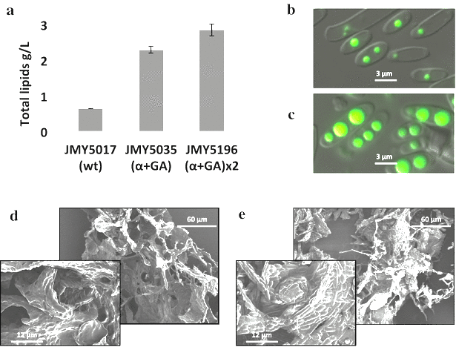
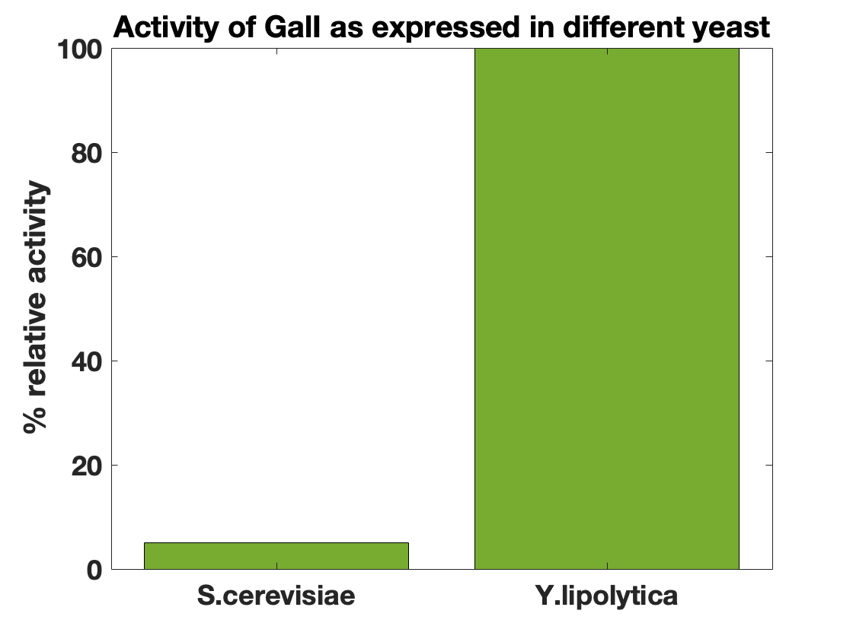
Yarrowia lipolytica, an excellent protein factory
Main interesting features, excellent at:
Secreting protein
Hydrolysing lipids
Degrading extracellular proteins
Right: Biodiesel production
Bottom: Beta-carotene production
Sven Müller et al., Yeast 1998 (Modified)
Notes:
Much better at secreting proteins which facilitates task as purification or extraction by cell lysis not necessary. Also S. pombe and H polymorpha showed poor transformation efficiency and protein glycosylation problems rendering Y. lipolytica the best non-conventional candidate to dethrone S. cerevisiae. Additionally, large toolbox, with sequenced genome, well characterized constitutive and inducible promoters, terminators, high throughput– high efficiency transformation protocols, golden gate assembly method for YL, selection markers, codon optimization tools… with such tools Y.L strains have been engineered to thing such as accumulate lipids to be used as bioguel from raw starch and produce beta carotene

Slide 7


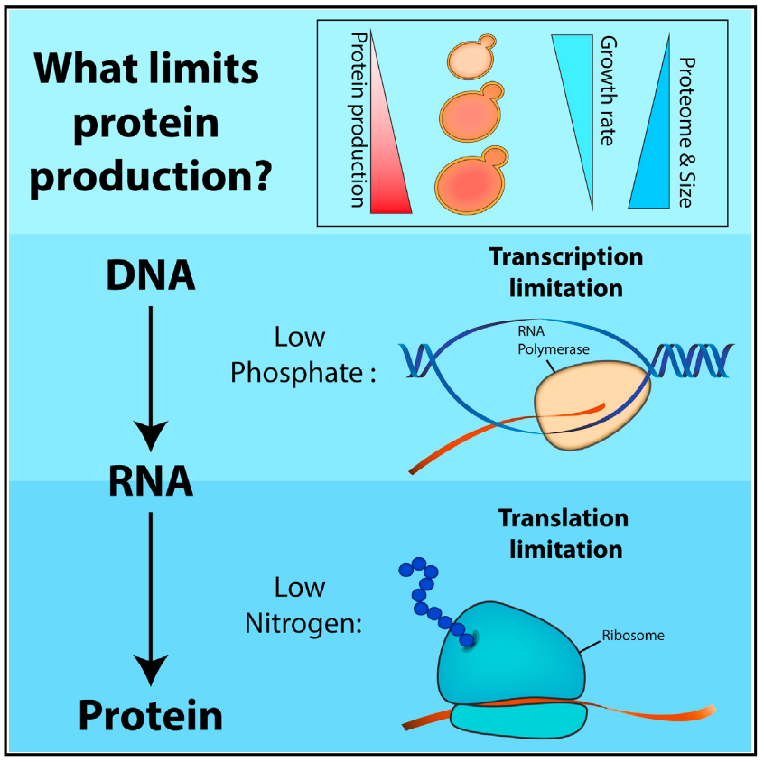
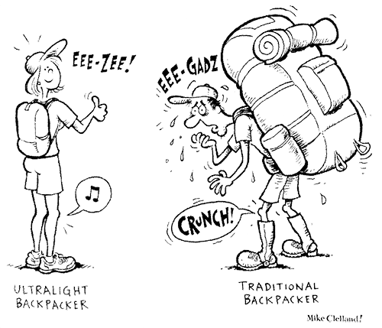



Metabolic burden & its impact on protein yield
‘Natural’ DNA
Synthetic DNA
The cost of protein production, Kafri et al., 2016 (Cell) [modified]
Burden occurs because of the consumption of vital finite cellular resources such as ribosomes, amino-acids or polymerases… (Ceroni et.al 2015)
HAPPY
CELL
OVERWORKED
CELL
Mike Clelland, ‘Lighten up’ - 2005
Yeast SEM from Biologics Interantional, Inc (2018)

Slide 8

AIM: IS Division of labour a solution to burden?
A
B
vs.
A
B
A_{e}
B_{e}
A_{e}
B_{e}
Single cell
system
Division of labour
system
Examples of successful microbial division of labour
can be seen in Brenner et.al, Cell (2008)

Slide 9
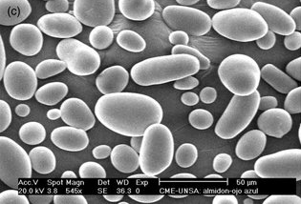
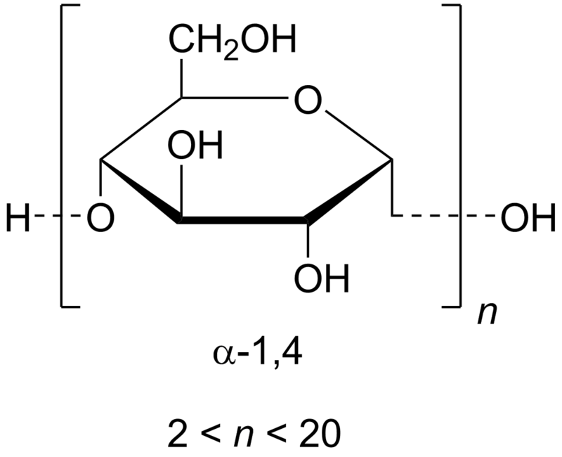
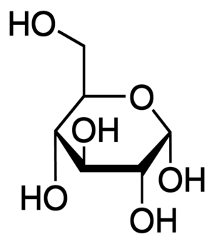
Starch digestion: a simple system for the study of cooperation
Chemical reaction
Enzymatic activity
AA
GA
Positive interaction
Secretion
Growth
AA_{e}
GA_{e}
Negative interaction
Starch is formed of granules formed of chains of glucose units: amylose and amylopectin.
Alpha-amylase breaks down starch granules releasing maltodextrin.
Glucoamylase breaks down maltodextrin chains releasing glucose units.
2015: Engineering of Y. lipolytica strain able to use starch as the only source of carbon., by Ledesma et.al
Achieved by successful expression and secretion of alpha-amylase from rice and glucoamylase from Aspergillus niger.
STARCH GRANULES
MALTODEXTRIN
GLUCOSE
AA
GA
AA_{e}
GA_{e}
AA
Alpha-amylase
GA
Glucoamylase
Cell – Y. Lipolytica
Notes:
Starch is formed of granules formed of chains of glucose units: amylose and amylopectin.
Alpha-amylase breaks down starch granules releasing maltodextrin.
Glucoamylase breaks down maltodextrin chains releasing glucose units.
2015: Engineering of Y. lipolytica strain able to use starch as the only source of carbon., by Ledesma et.al
Achieved by successful expression and secretion of alpha-amylase from rice and glucoamylase from Aspergillus niger.
Growth will only occur if the two enzymes are expressed in their active forms, problem with current starch degrading cells burden, hence impacting overall protein yield

Slide 10
Starch digestion: a simple system for cooperation
Chemical reaction
Enzymatic activity
AA
GA
Positive interaction
Secretion
Growth
AA_{e}
GA_{e}
Negative interaction
STARCH GRANULES
MALTODEXTRIN
GLUCOSE
AA
GA
AA_{e}
GA_{e}
AA
Alpha-amylase
GA
Glucoamylase
Cell – Y. Lipolytica
Notes:
Growth will only occur if the two enzymes are expressed in their active forms, problem with current starch degrading cells burden, hence impacting overall protein yield

Slide 11
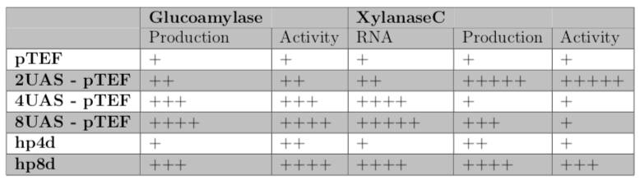
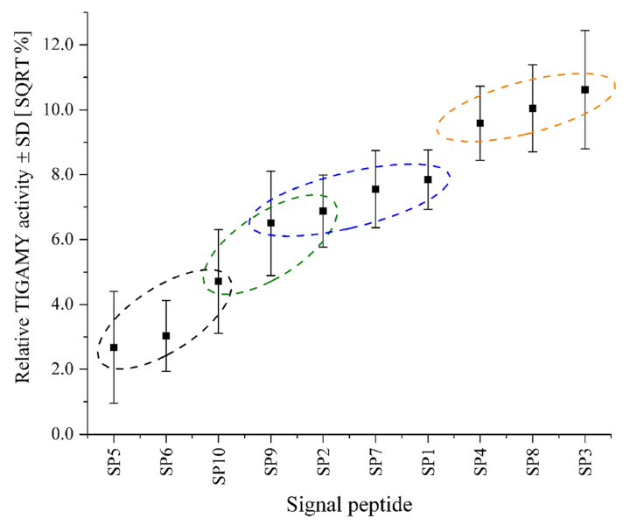
Promoter library characterization for glucoamylase and xylanaseC
Signal-peptide & promoter library to improve starch digestion
Signal peptide characterization for glucoamylase
Signal peptide characterization for glucoamylase
Notes:
To lighten burden from expression of amylase we aim at optimizing expression of each amylases with a characterized library of signal peptides and promoters. Signal peptides are a sequence in each protein that signal peptidase recgonises and which regulates secretion rate of protein. Promoters regulate transcription rate. In our study we aimed at constructing.
For proms: important to note that glucoamylase expression increases gradually with the number of UAS units whereas XylanaseC maximum which is the most important to us is greater for 2pTEF.
For Sps:
Importnant to note that a variant of sp6 (signal peptide from Lip2) was the one used in original paper of starch digestion and that activity is boosted approximately 5 times with SP8,SP3, or SP4 with respect to SP6

Slide 12


SP1
Signal-peptide & promoter library to improve starch digestion
GA
SP2
SP3
AA
SP4
pTEF
GA
T1Lip2
URA3
SP5
Glucoamylase
SP6
pTEF
SP7
70
2UAS
pTEF
SP8
AA
SP9
3UAS
pTEF
SP10
4UAS
pTEF
GA
AA
T1Lip2
LEU2
8UAS
pTEF
SPLip2
Alpha-amylase
AA
GA
7
10
70
hp4d
AA
GA
hp8d
7
10
Notes:
We aim at assembling these new plasmids containing the variations of AA and GA separately as well as in the same plasmids. We already have those strains that expresses GA linked to the different signal peptides but we are missing the AA ones and the AA +GA ones.

Slide 13
Results & discussion
Assembly of new strains
Burden analysis of all strains
Growth in starch of single cells & cocultures

Slide 14
Result 1: PROBLEM WITH GENE assembly method
Deepest problem related to kit by student last year
WE MOVE ON!
Notes:
Attempted to assemblew AA plasmids from sracth using golden gate, got really low efficiency of transformations and in the end found out it was because of wrong individual parts, the riceAA part was corrupted resulting a large deletion, and there were repeated problems with the terminator T1Lip2m which suggest something may be wrong with that part. These finding on the assembly method revealed some deeper problems with the assembly kit we were using which triggered work towards repairing it. Unfortunately the kit could not be ready by the time I wanted to use it and these strains could not be integrated into my report.
Despite continuous efforts in assembling the new strains COULD NOT BE ASSEMBLED, this trend of failed golden gate reactions and transformation follows a trend in the lab we have had where certain golden gate parts were consistently failing. Due to lack of time we moved on!
Next steps will be to sequence all level 0 parts before moving on.

Slide 15
SHIFT TO THE STUDY of THE STRAINS WE HAVE
AA
GA
AA
GA
Y5017
Y5196
70
2
AA
GA
AA
GA
Y1-Y10
7
10
1
10
Y5077
Y1-Y10: SP1-10+TIGAMY
Y5077: pTEF-riceAA
Y5017: ANGAMY+riceAA
Y5196: 2x(Y5017)

Slide 16
SHIFT TO THE STUDY of THE STRAINS WE HAVE
AA
GA
AA
GA
Y5017
Y5196
70
2
AA
GA
AA
GA
Y1-Y10
7
10
1
10
Y5077
Y1-Y10: SP1-10 + GA
Y5077: pTEF + AA
Y5017: GA + AA
Y5196: 2x(GA + AA)

Slide 17
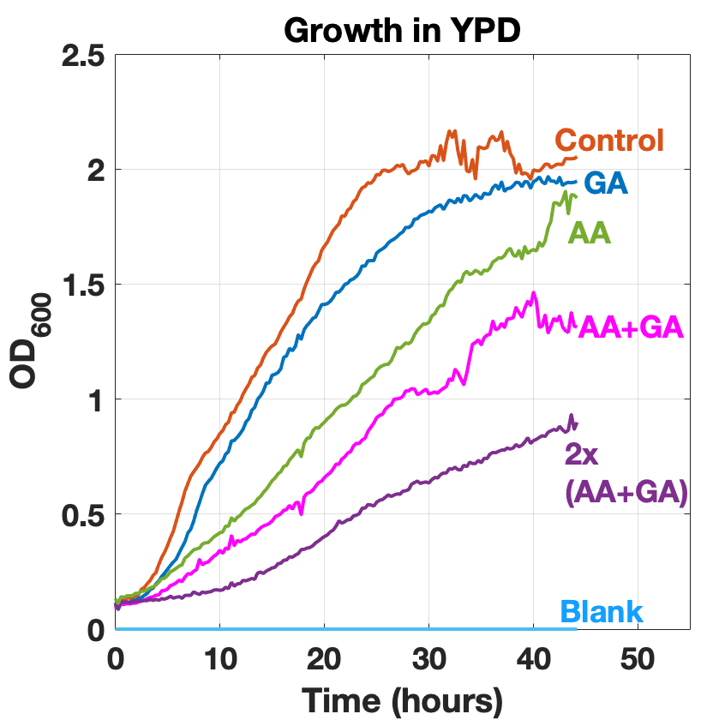
BURDEN ANALYSIS
GA: burden +/-
AA: burden +
AA & GA: burden ++
Average growth of strains in rich media (n = 3)
Notes:
Here we can see the average growth of all strains after a period of 35 hours, we can see all the strains expressing GA are clustered and show growth similar to the positive control Y2900. Y195 exhibits a slower growth and we can see the more we ask the strains to express the slower and lower the growth will be with the examples of y5077, y5017 and 5196. as expected growth is diminished in minimal media where the effects of burden are perhaps not as notorious. Conclusion of this result Y5077 affects cell growth significantly with respect to y2900 as well as y517 and y5196. AA expression seems to be the main cause of burden in strains 5017 and 5196

Slide 18
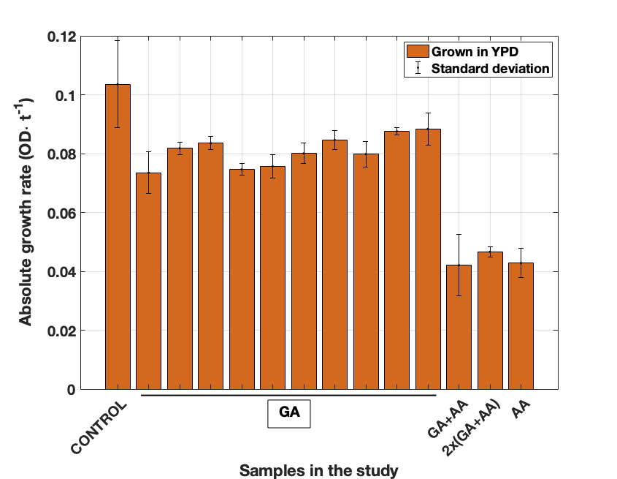
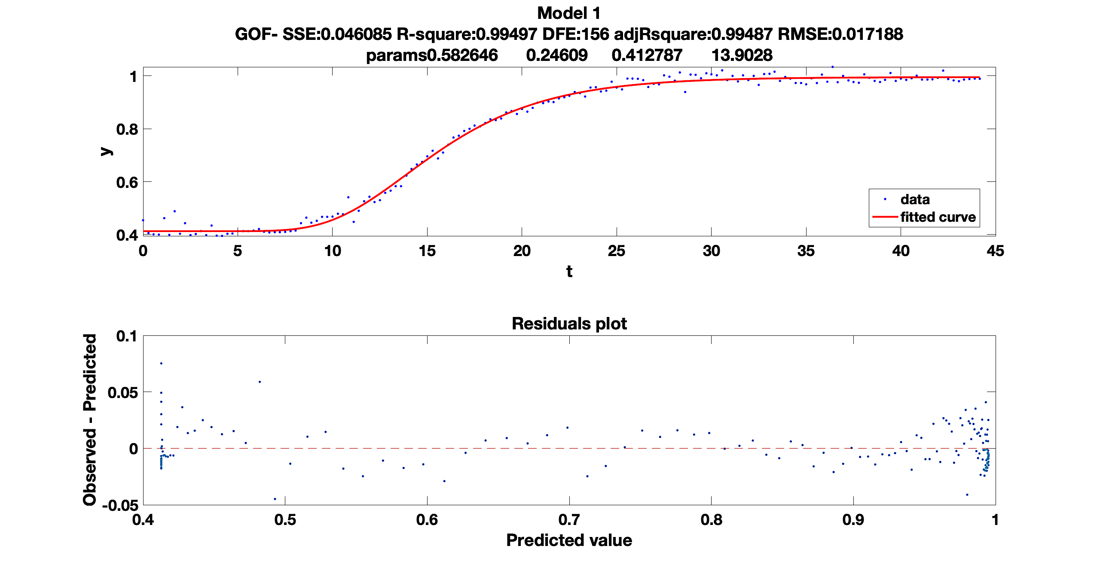
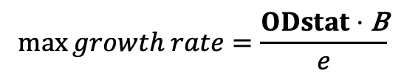
QUANTIFYING BURDEN WITH CURVE FITTING
$$OD\left(t\right)=OD0+ODstat⋅\exp{[−\exp\left(−B(t –\text{t} \text{M} \right)]}$$
Burden is conceptually defined as “the fractional reduction in growth rate” (Shachrai et.al, Molecular Cell (2010))
$$\max{growth rate}=\frac{ODstat⋅\text{B}}{e}$$
Notes:
Present quote, and if we can calculate growth rate from curves we have a meqasure to quantify burden, problem is it is difficiult to programattically extract the point of max growth rate from a growth curve (for example using the derivative of the growth rate – at least I have found that problem PUT GROWTH RATE CURVES IF NECESSARY). Therefore I decided to develop a regression system to find the characteristic parameters to each growth curve as developed by Gibson et al in 1998
NOTE THE FITTER WORKS BETTER WITH LONGER RATHER THAN SHORTER LAG PHASES
MAIN CONCLUSION TO BURDEN: GA DOES NOT IMPACT GROWTH MUCH, IRRESPECTIVE OF THE SIGNAL PEPTIDE, HENCE BEST SIGNAL PEPTIDE BEST TO USE.
SECOND CONCLUSION: AA AFFECTS GROWTH A LOT AND CELLS THAT CAN LIVE ON STARCH AREN’T VERY HAPPY IN RICH MEDIA.

Slide 19
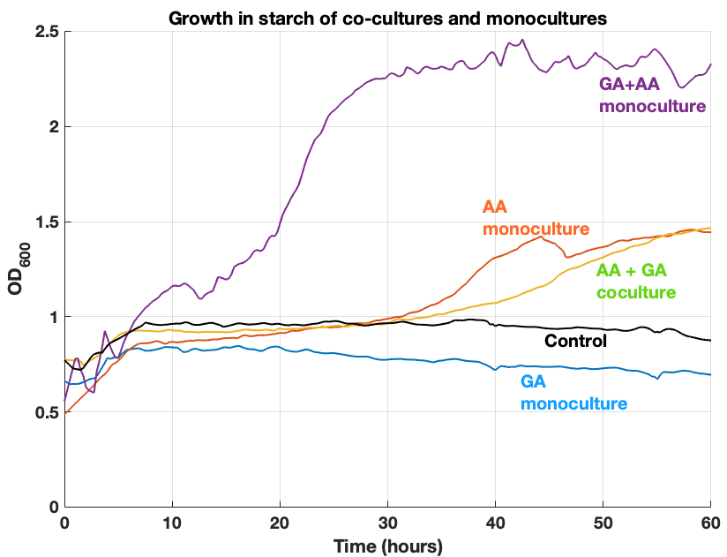
Monocultures vs. cocultures in starch
RESULT:
CO-CULTURES NOT BETTER THAN MONOCULTURES AT THIS STAGE
REASON: COMPETITION OF RESOURCES OR ONE OF THE CELLS IS A CHEAT
Notes:
DESCRIBE FIGURE THEN, STATE HOW GROWTH OF 5017 IS WAAY ABOVE OTHER AND HOW AA ALSO GROWS WHICH CONTRADICTS PREIVOUS DATA, STATE HOW CO-CULTURE ONLY SEEM TO INCREASE THE LAG PHASE WHICH SUGGEST A POSSIBLE COMPETITION FOR RESOURCES OR one of the cell is a cheat who is not doing much job and just consuming resources.
Growth from cocultures reach a maximum 40% smaller than growth by the single cell living off starch, hence at this stage usage of cocultures is not useful to improving starch digestion efficiency.

Slide 20
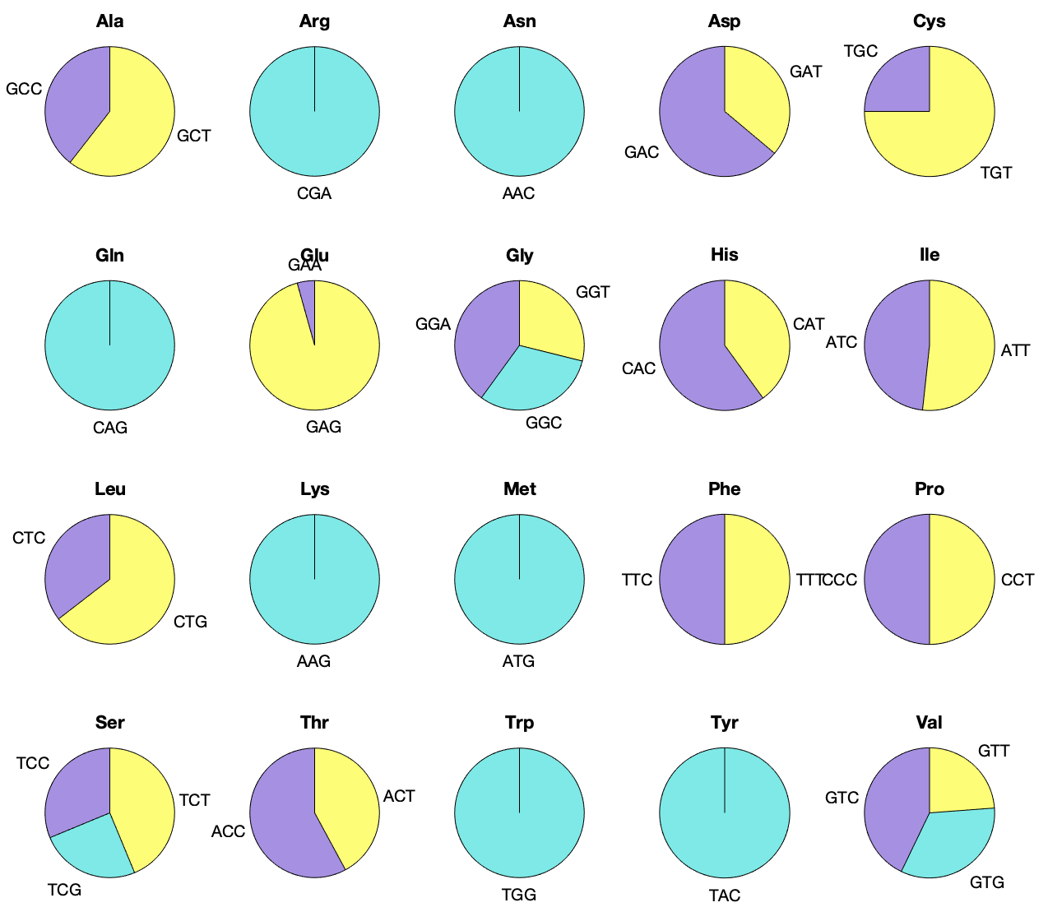
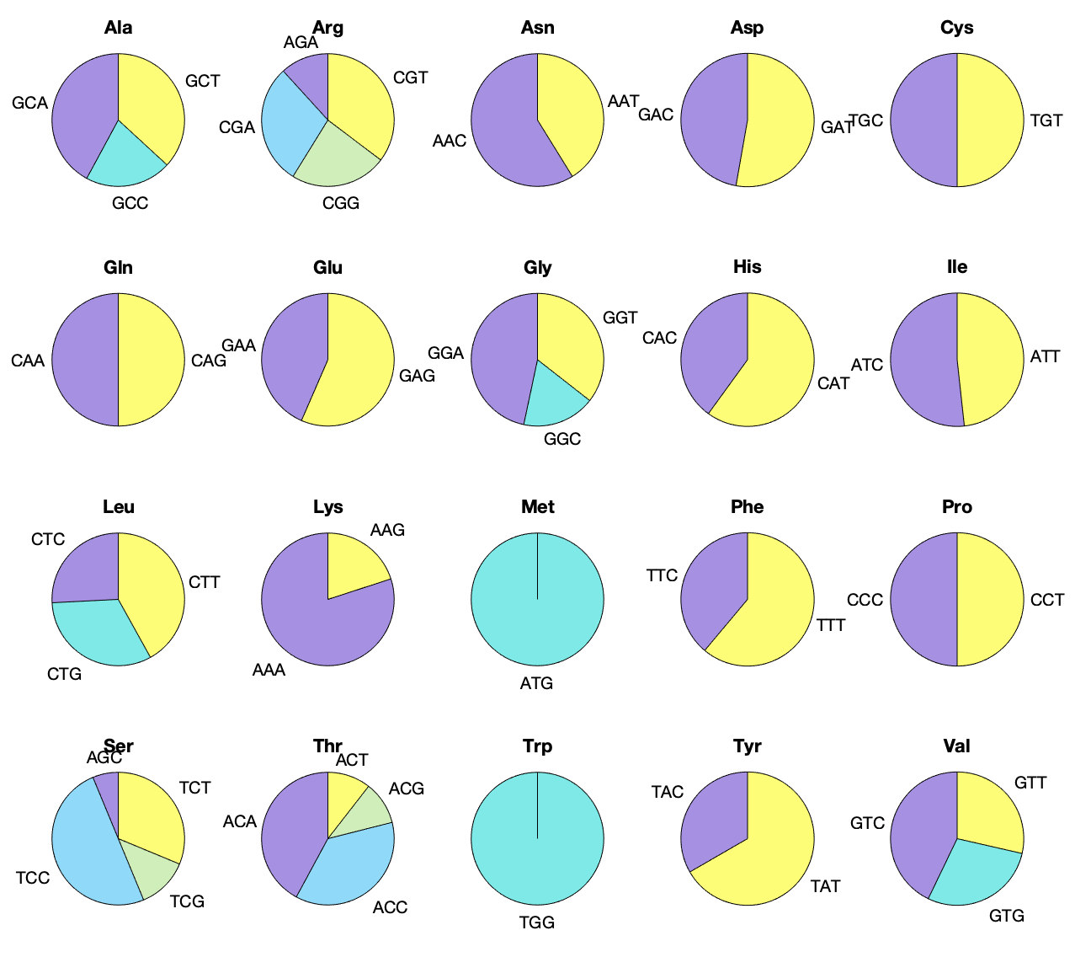
𝜶-amylase expression problem could be due to codon non-optimality
Original sequence of rice AA
as used by Ledesma et.al (2015)
Optimised sequence (IDT) of rice AA
Notes:
Reference on cases where codon optimality solution shave led to greater protein yields.
Codon optimization can improve burden as synthesis of rare aminoacids would be reduced and those rare amino acids culd go towards more vital fnctions
Mention codon usage more certain aminoacids is more balanced than in the previously optimized version with GenScript
Different companies use different algorithms, hence it would be interesting to see if the alpha-amylase optimized aanother way was any better than the one optimized with genscript.

Slide 21
CONCLUSION FROM OUR WORK
GA does not cause significant burden, irrespective of signal peptide.
AA causes significant burden on cells.
1st time quantification of burden of amylases in Y. lipolytica.
Coculture not a solution for starch digestion at this stage.
Assembly of new strains → High-troughput growth-assays in automated stations.
NEXT STEPS…
Notes:
Add references

Slide 22
THANKS FOR LISTENING!
END

Slide 23
Limitations of our study & future work
Usage of several different glucoamylases affects comparability.
Failure of assembly of new plasmids and all combinations of signal peptides and promoter library.
Simplicity of co-culture study.
Only one alpha-amylase studied.
Sequencing of GG parts and assembly of new plasmids.
High-throughput transformation and verification protocols for new Y. lipolytica strains.
High-troughput growth-assays in automated stations.
Characterisation of enzymes kinetics & stoichiometry and optimal conditions for starch digestion.
Study of other alpha-amylases along with burden characterization
Modelling of the reaction and cell-cell interactions
Fluorescently tagged amylases to track co-cultures
High-throughput co-culture studies in microfluidic devices
Notes:
Add references

Slide 24
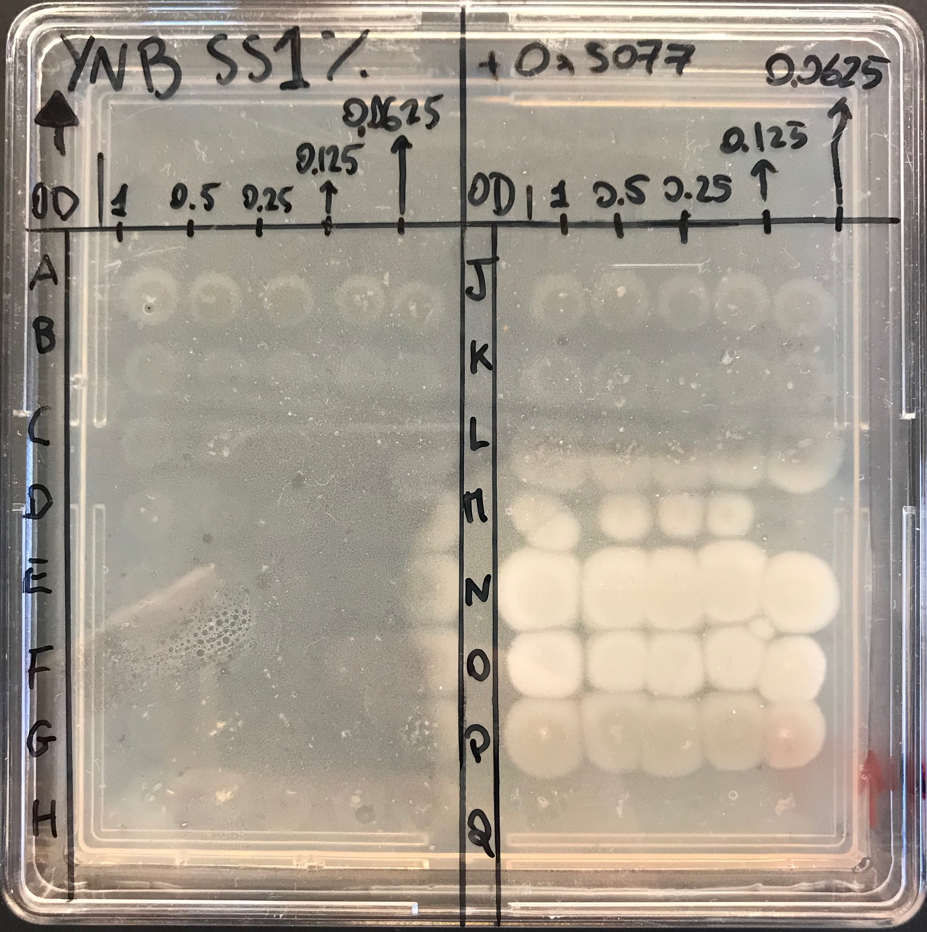
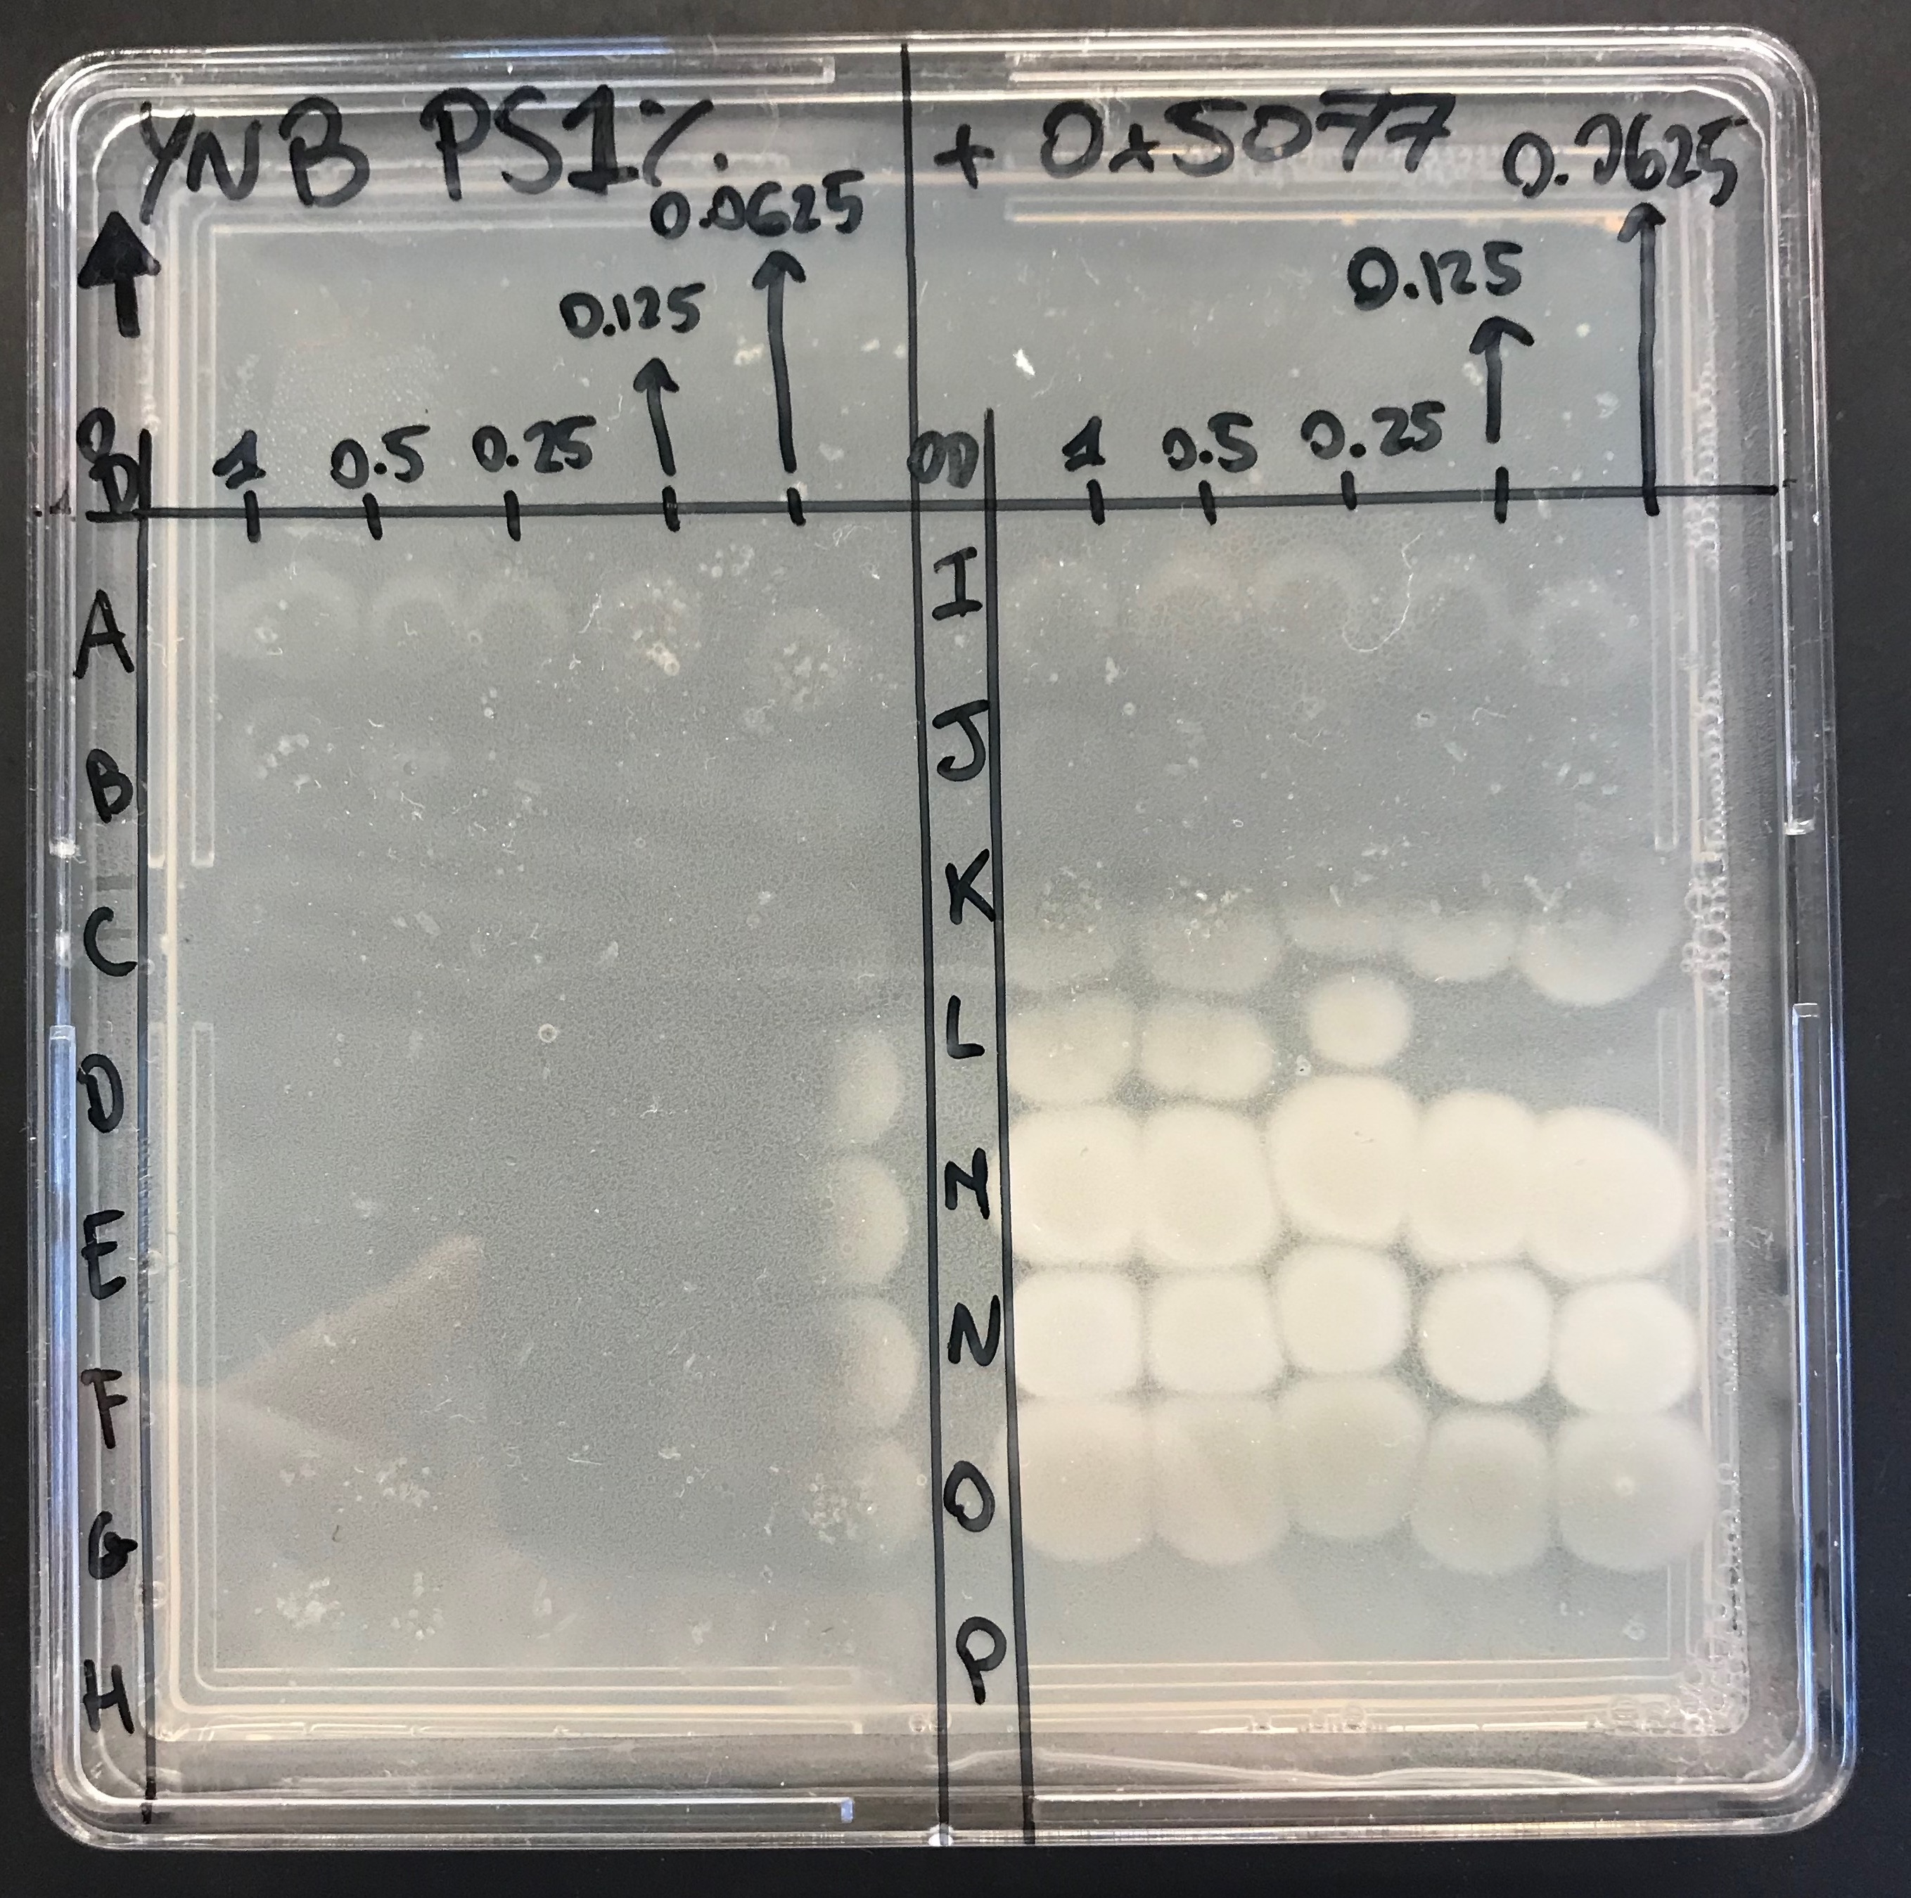
GROWTH IN STARCH
Y1-Y10: SP1-10+TIGAMY
Y5077: pTEF-riceAA
Y5017: ANGAMY+riceAA
Y5196: 2x(Y5017)
Y2900: prototroph, no extra construct
Y195: URA and LEU auxotroph
Notes:
DESCRIBE FIGURE THEN, STATE HOW GROWTH OF 5017 IS WAAY ABOVE OTHER AND HOW AA ALSO GROWS WHICH CONTRADICTS PREIVOUS DATA, STATE HOW CO-CULTURE ONLY SEEM TO INCREASE THE LAG PHASE WHICH SUGGEST A POSSIBLE COMPETITION FOR RESOURCES OR one of the cell is a cheat who is not doing much job and just consuming resources.

Slide 25
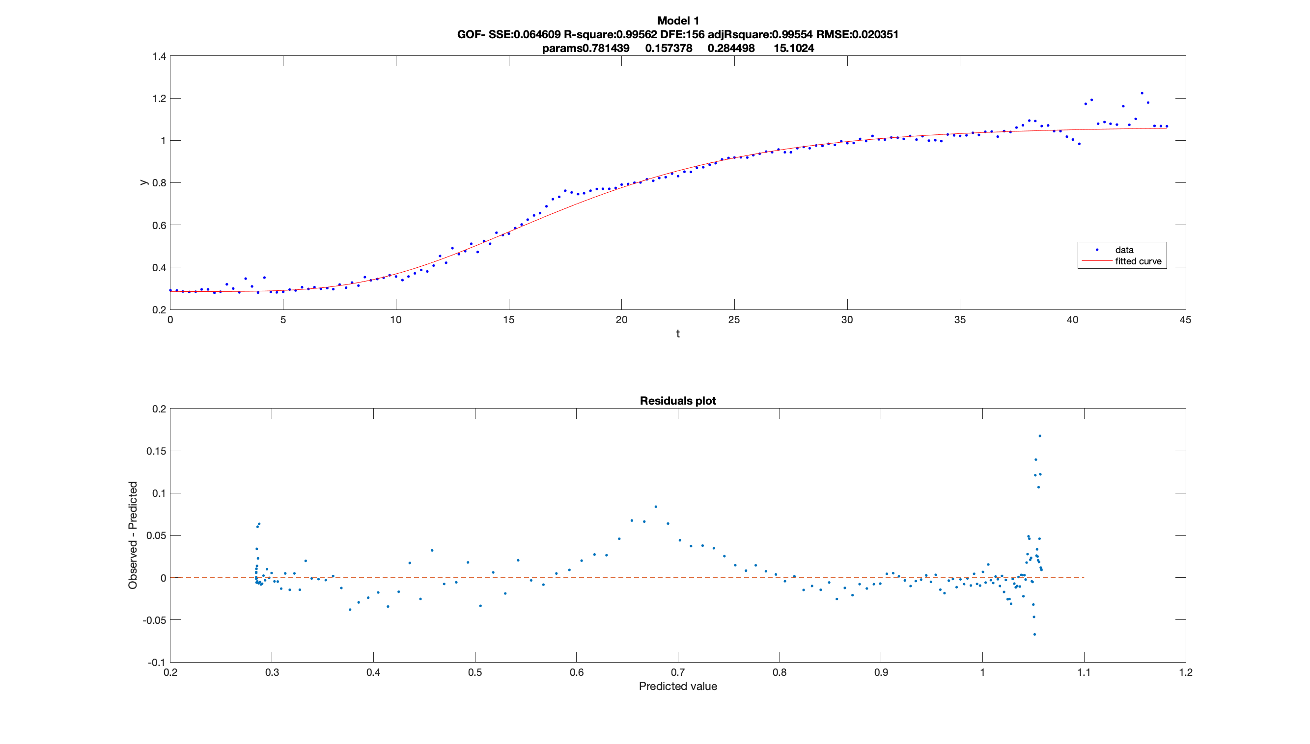
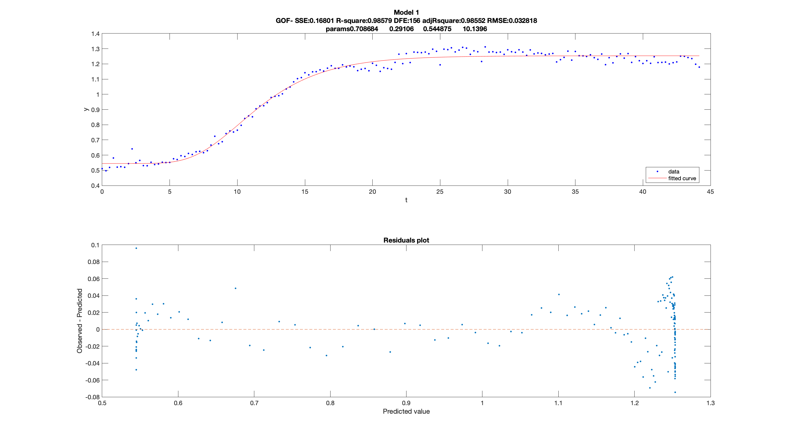

Slide 26
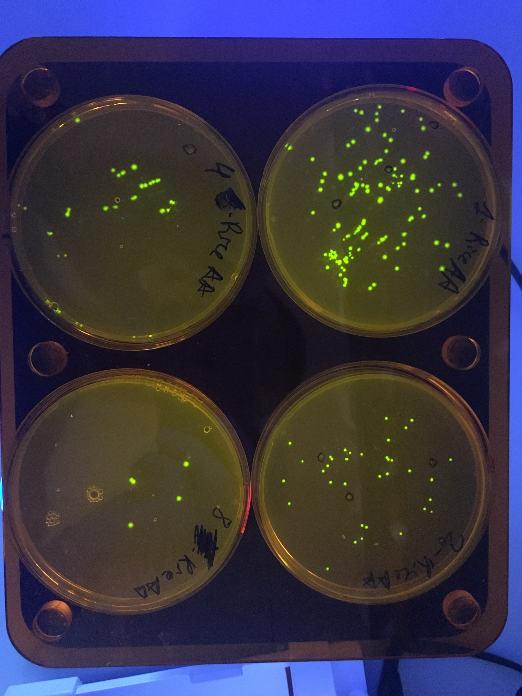
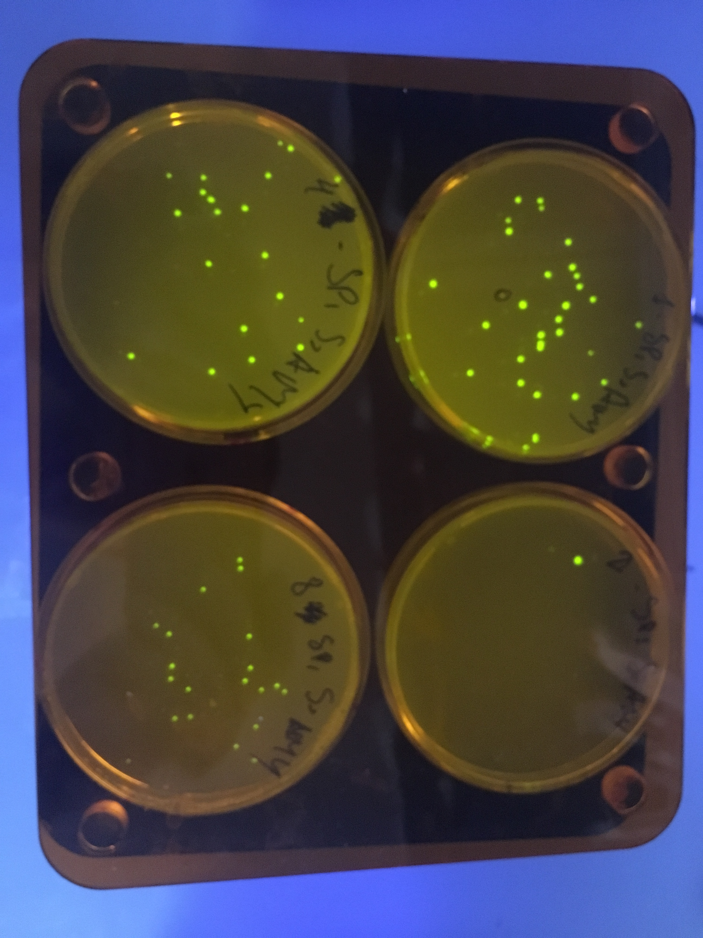
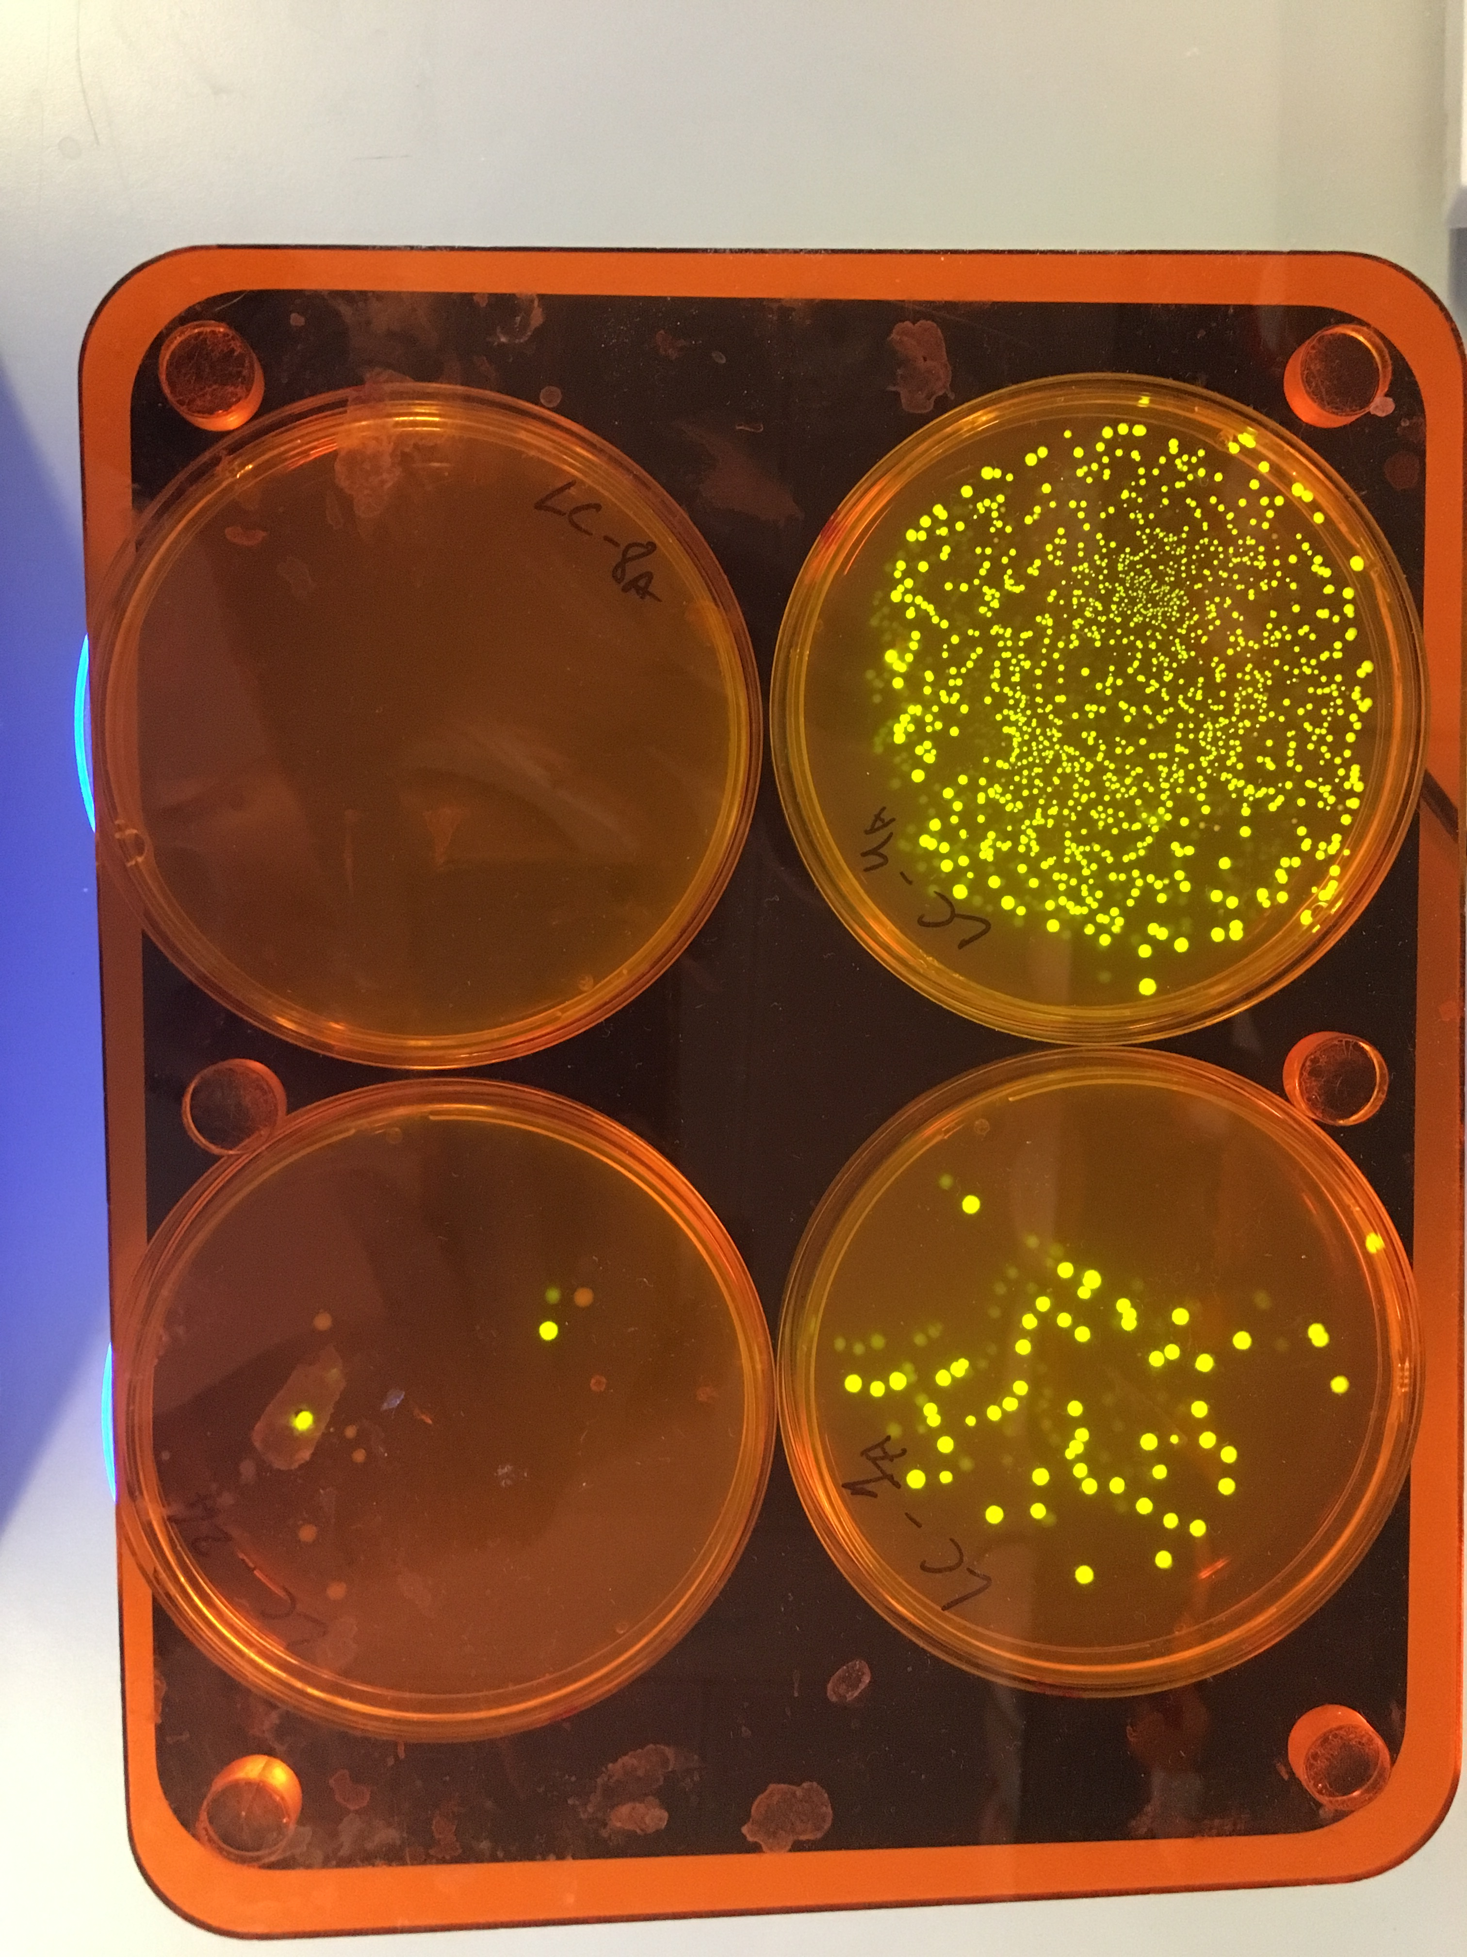
Result 1: failure at assembling new strains
Notes:
Attempted to assemblew AA plasmids from sracth using golden gate, got really low efficiency of transformations and in the end found out it was because of wrong individual parts, the riceAA part was corrupted resulting a large deletion, and there were repeated problems with the terminator T1Lip2m which suggest something may be wrong with that part. These finding on the assembly method revealed some deeper problems with the assembly kit we were using which triggered work towards repairing it. Unfortunately the kit could not be ready by the time I wanted to use it and these strains could not be integrated into my report.
Despite continuous efforts in assembling the new strains COULD NOT BE ASSEMBLED, this trend of failed golden gate reactions and transformation follows a trend in the lab we have had where certain golden gate parts were consistently failing. Due to lack of time we moved on!
Next steps will be to sequence all level 0 parts before moving on.

Slide 27
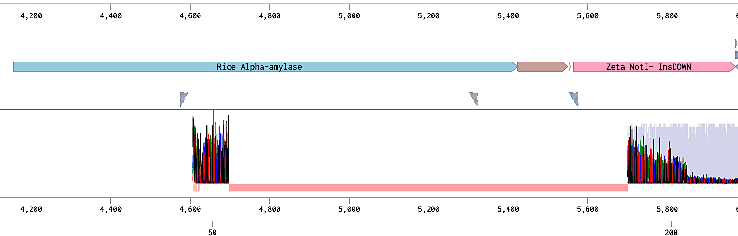
Result 1: Problems in assembly of new strains
Sequencing data for one of the failed new constructs
Notes:
Attempted to assemblew AA plasmids from sracth using golden gate, got really low efficiency of transformations and in the end found out it was because of wrong individual parts, the riceAA part was corrupted resulting a large deletion, and there were repeated problems with the terminator T1Lip2m which suggest something may be wrong with that part. These finding on the assembly method revealed some deeper problems with the assembly kit we were using which triggered work towards repairing it. Unfortunately the kit could not be ready by the time I wanted to use it and these strains could not be integrated into my report.
Despite continuous efforts in assembling the new strains COULD NOT BE ASSEMBLED, this trend of failed golden gate reactions and transformation follows a trend in the lab we have had where certain golden gate parts were consistently failing. Due to lack of time we moved on!
Next steps will be to sequence all level 0 parts before moving on.

Slide 28
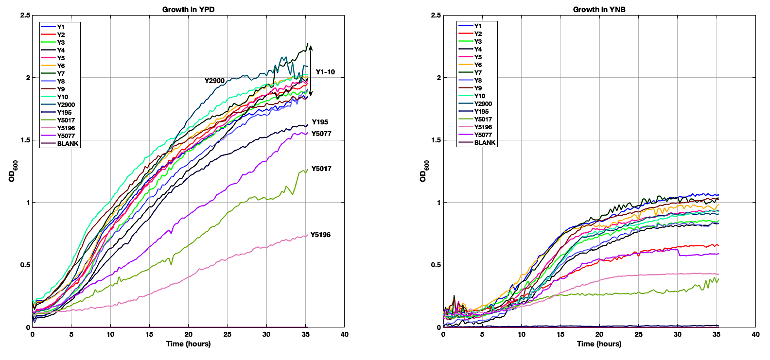

Slide 29
